Slide 1
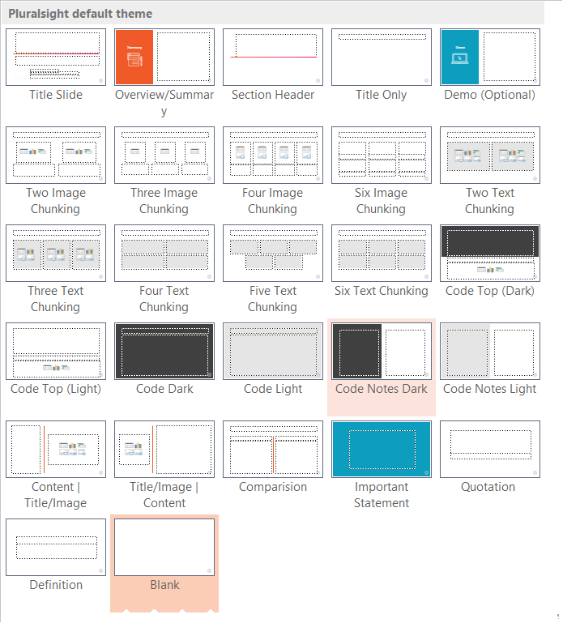
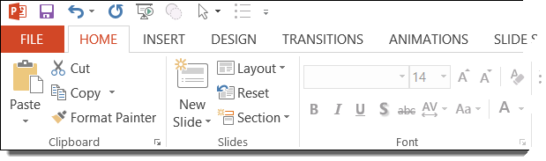

Pluralsight Audition Template
This slide deck template is for Pluralsight audition purposes only.
If approved, you’ll receive a new slide deck for actual course production.
The slides in this deck are examples of how to use the layouts in the template.
The slides also contain helpful tips for recording your audition.
Use or delete any of the example slides, however you must at least have a title slide.
Additional layouts can be found from the “New Slide” menu.
Please delete this helper slide before recording

Slide 2

This is the Title
Author Name
Author Title in Title Case
@socialmedia | www.authorsite.com

Slide 3
This slide is preset with animations
Use this layout to introduce (at the beginning) and/or summarize (at the end) the audition
Don’t just read a list of topics
Build excitement
Tell the viewer why this is important
  Where would they use this
  info on the job?

Slide 4
Audition Tips
Also read the online Audition
Kit documentation:
www.pluralsight.com/teach/resource/auditions
Teach with absolute technical accuracy
Construct a compelling and engaging storyline
Begin with WIIFM (what’s in it for me?)
Present a problem, guide the viewer on a journey, and end with a clear solution
We’re not looking for a tutorial, we’re looking for you to demonstrate teaching skills

Slide 5



Do your best with these skills, but they are secondary to teaching skill:
Audio quality
  Editing prowess
  PowerPoint skills

Slide 6
Auditions Do Focus On
What We Look At
What We Look For
Storyline
Visuals
Narration
End result
Is it engaging to the viewer?
Are they effective to reinforce key points?
Do you present a well-narrated demo with confidence and passion (expert human being versus a bored robot?)
Would you watch this video?

Slide 7
A Great Author Is
Charismatic
Knowledgeable
Confident
Conversational
Engaging
Accountable

Slide 8
This slide is preset with animations
Use this layout to introduce your demo
How to do this one thing
  Why we do it
  How we do it
Then there’s that thing
Don’t forget to do this
We’ll finish it off with this thing

Slide 9
Give a conceptual summary, don't just list the topics you covered
What can the viewer do now that they couldn't do before?
You told the viewer in the overview why this was important
  Did you deliver?

